Slide 1
Sales Forecast for Super Cue Boba Shop
Tom Cheng
Datas Science Career Track Capstone, May 20th 2020 Cohort

Slide 2

Why Forecast?
Sales forecast helps control inventory, efficient staffing, and predict profits.
Most of boba shops are small shops, and thus everything counts. Especially staffing, an extra staff per day can take away up to 15% of daily revenue!

Slide 3




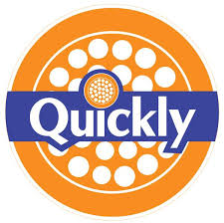



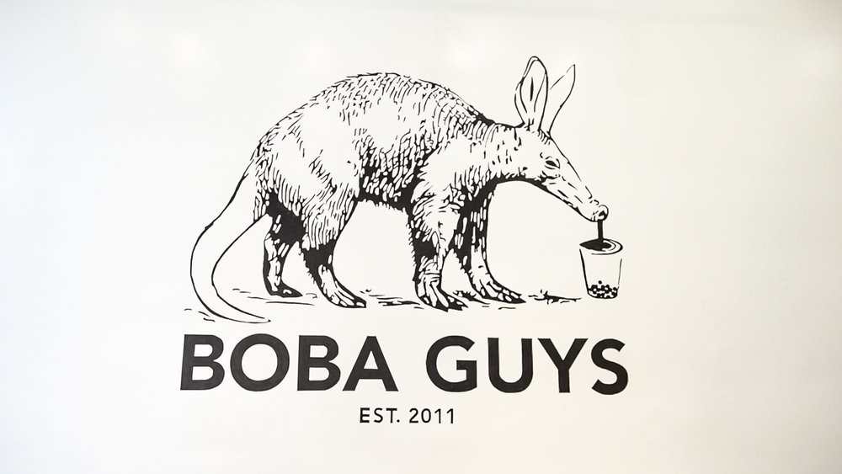

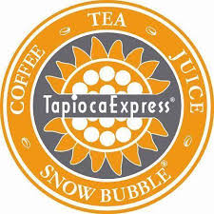
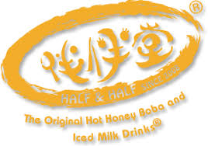


What Boba Shops? And many more…

Slide 4

What’s needed to do sales forecast?
Use common sense and logics to find factors that may influence sales, in most cafes/restaurants: TIME
Data: past sales and factors

Slide 5
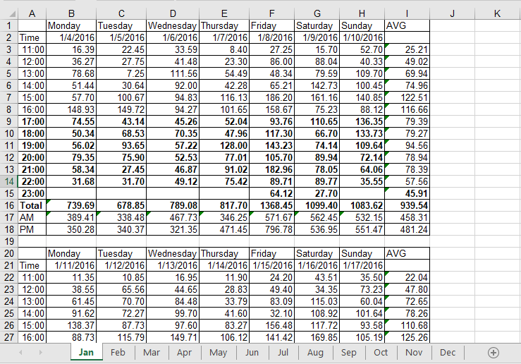
Where my data came from?
I was able to get 2 years (2016&2017) of hourly sales data from Super Cue Café.
The files were in csv format; two files, with 12 sheets (one month per sheet).

Slide 6
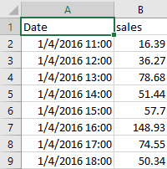
What should time series data look like? https://github.com/tc18fwd/SpringBoard/blob/master/Capstone%20Two/Capstone%202%20Data%20Wrangling.ipynb
Ultimately, we will want a time series data with the following format:
Row index in time series format
Columns with factors that influence sales (if any), and most importantly: Sales

Slide 7
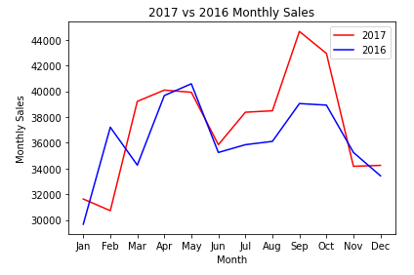
Exploratory Data Analysis (EDA) https://github.com/tc18fwd/SpringBoard/blob/master/Capstone%20Two/Capstone%202%20EDA.ipynb
Comparison between 2016&2017
By Month (12)
By Week (52x7)
Day of Week (7)
Hour of Day (11AM~Close)

Slide 8
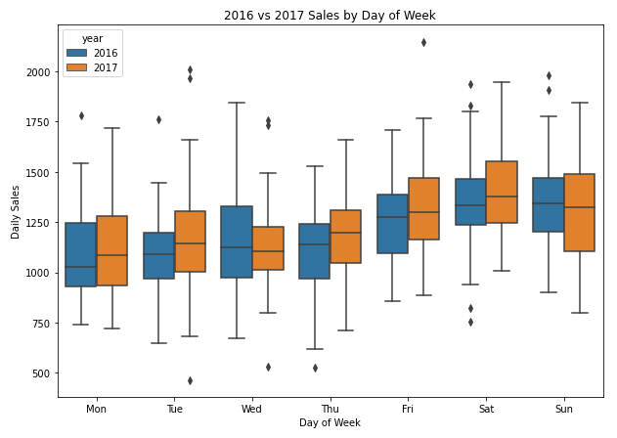
EDA cont. https://github.com/tc18fwd/SpringBoard/blob/master/Capstone%20Two/Capstone%202%20EDA.ipynb
2016 vs 2017 average daily sales boxplot
Why boxplot?
Median
IQR
Shows Outliers

Slide 9
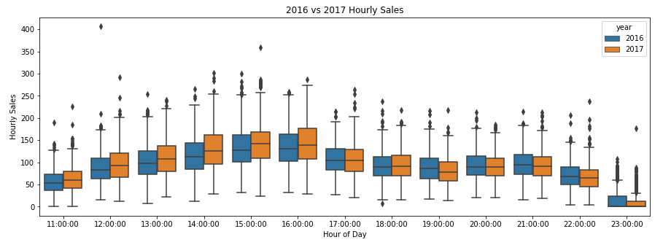
EDA cont. https://github.com/tc18fwd/SpringBoard/blob/master/Capstone%20Two/Capstone%202%20EDA.ipynb

Slide 10
Machine Learning Modeling https://github.com/tc18fwd/SpringBoard/blob/master/Capstone%20Two/Capstone%202%20Finalized%20Codes.ipynb
Type: Time Series Forecast
Tools: pandas, numpy, matplotlib, seaborn, statsmodels.api (for ACF), sklearn.metrics, datetime
Methods/Models:
Autoregressive Integrated Moving Average (ARIMA)
Seasonal Autoregressive Integrated Moving-Average (SARIMA)
Seasonal Autoregressive Integrated Moving-Average with Exogenous Regressors (SARIMAX)
Holt Winter’s Exponential Smoothing (HWES)
TBATS (Trigonometric Exponential Smoothing State Space model with Box-Cox transformation, ARMA errors, Trend and Seasonal Components)

Slide 11
Modeling Steps https://github.com/tc18fwd/SpringBoard/blob/master/Capstone%20Two/Capstone%202%20Finalized%20Codes.ipynb
Data Preprocessing: time series format, no missing values, add exogenous if needed (SARIMAX).
Split to train/test, 50/50 for hourly dataset, 80/20 for daily.
Use grid search to find best hyperparameters for each model
Use MAE and fitting time to evaluate the model’s performance

Slide 12
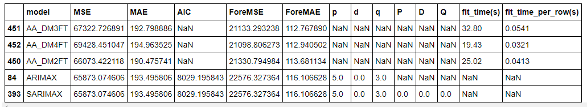
Modeling (Day) https://github.com/tc18fwd/SpringBoard/blob/master/Capstone%20Two/Capstone%202%20Finalized%20Codes.ipynb
Top models by ForeMAE
TBATS, ARIMAX, SARIMAX, auto_arima were the only models that were able to capture yearly seasonality (visually). And this table concludes the top model metric scores based on 2018 MAE (ForeMAE).
Winner: AA_DMFTs

Slide 13
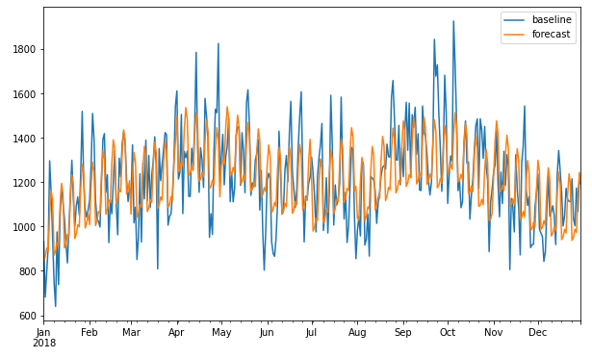
Modeling (Day) cont. https://github.com/tc18fwd/SpringBoard/blob/master/Capstone%20Two/Capstone%202%20Finalized%20Codes.ipynb
AA_DF2FT 2018 baseline vs pred
What is AA_DM2FT
AA for auto_arima, which is a form of SARIMAX that automatically finds the optimal hyperparameter for SARIMAX
DM for the exogenous variable: Day of Week, and Month.
2FT for 2 Fourier-term

Slide 14
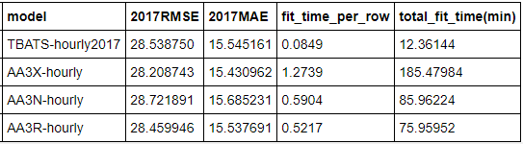
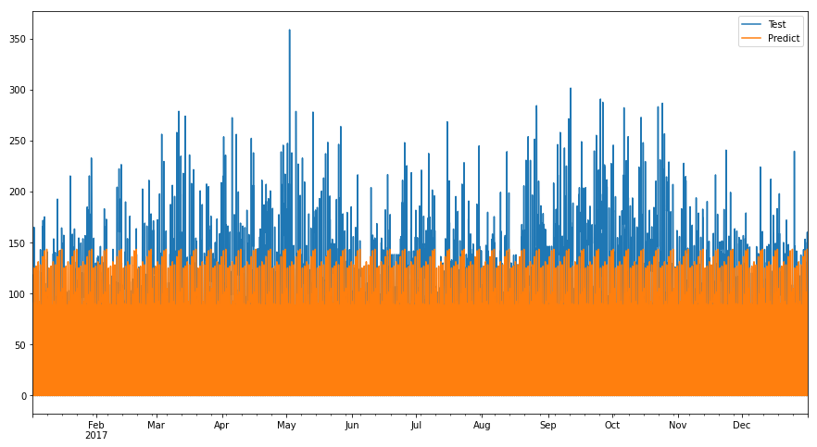
Modeling (hour) https://github.com/tc18fwd/SpringBoard/blob/master/Capstone%20Two/Capstone%202%20Finalized%20Codes.ipynb
Top model scores by model type
TBATS 2017 hourly sales test vs pred
Pay attention to total_fit_time in minutes, there is an obvious winner. TBATS, but one problem: it doesn’t capture yearly seasonality (it gets hour of day and day of week).

Slide 15
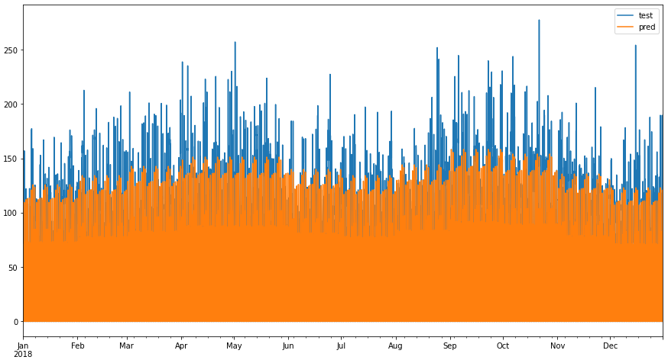
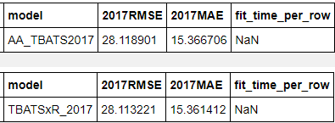
Modeling (hour) https://github.com/tc18fwd/SpringBoard/blob/master/Capstone%20Two/Capstone%202%20Finalized%20Codes.ipynb
TBATS with yearly seasonality
TBATSxTBATS(month) 2018 baseline vs prediction
Yearly seasonality added by multiplying ratios derived from monthly sales prediction by auto_arima (AA) and by manual calculation (R).

Slide 16
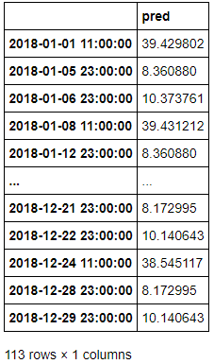
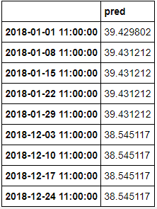
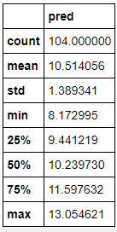
Use the model to find optimal store hours
Time where pred < 40
11:00 where pred < 40
11pm and pred < 40
Recommend to open from 11AM to 11PM everyday.
This may have saved about 104*27=2808 dollars per year, and have happier staffs.

Slide 17
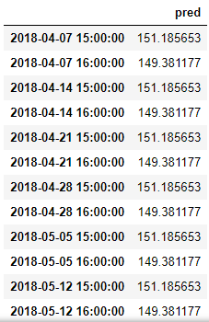
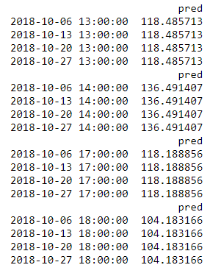
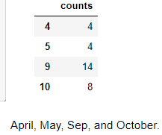
Use the model to find peak hours
Hours with sales above 149
No. of time sales was over 150 at 3pm
2 hr before/after peak hour

Slide 18
Recommendation for Super Cue
It's recommended for Super Cue to have 3 staffs during these hours
April and May's Saturday: 1PM to 5PM
September's weekends (Fri to Sun): 2PM to 6PM
October's Saturday and Sunday: 1PM to 5PM
And have store open from 11AM to 11PM everyday

Slide 19
Limitations & Ideas to Improve Prediction
All the models did not account holidays, events, temperature, and weather. Which are all factors to forecast sales, especially for drinks. So please do expect differences if the above mentioned factors were to be considered, e.g. you should expect more sales on a hot day, and less when it’s raining.
If the factors mentioned above could be implemented in the model, the prediction will definitely be better. However, models with multivariable factors will be very time consuming and data demanding.

Slide 20
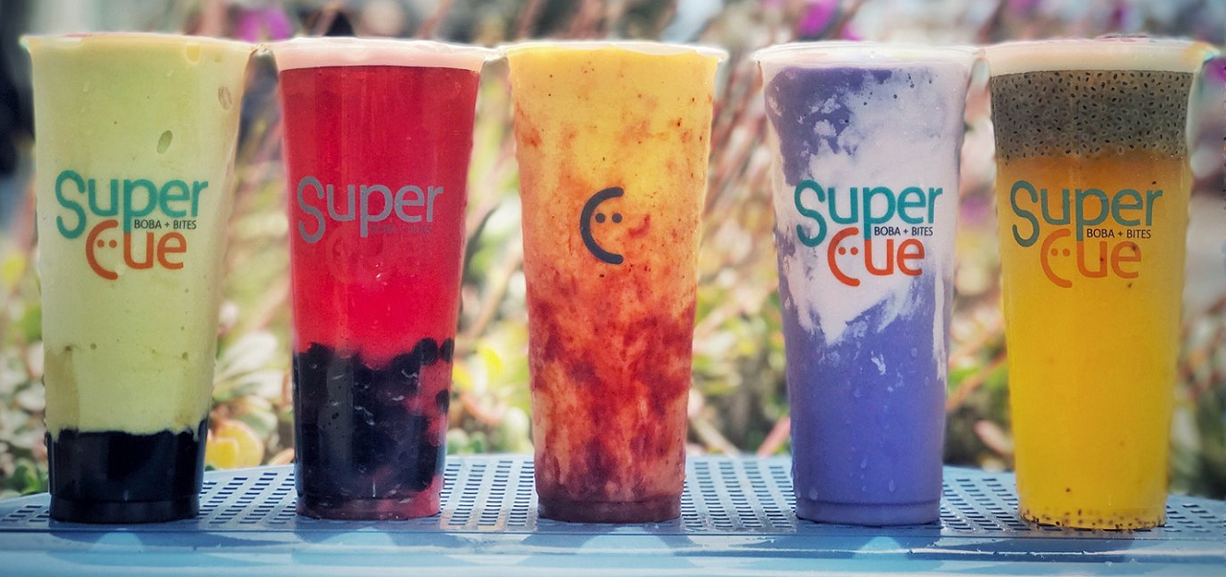
THANK YOU!

